Slide 1


Hii, Iam Siddhika
Welcome to Power BI Series
Part -18

Slide 2

Today Content
I’m soo Excited.
Are you ready guys?
Meet DAX
CALCULATED COLUMNS
EXAMPLE: CALCULATED COLUMNS MEASURES

Slide 3

CALCULATED COLUMNS
Calculated columns allow you to add new, formula- based columns to tables in a model
Calculated columns refer to entire tables or columns.
Have you got it?
Calculated columns generate values for each row, which are visible within tables in the Data view
Calculated columns understand row context; they’re great for defining properties based on information in each row, but generally useless for aggregation (sum, count, etc.)
TIP:
Calculated columns are typically used for filtering & grouping data, rather than creating aggregate numerical values

Slide 4
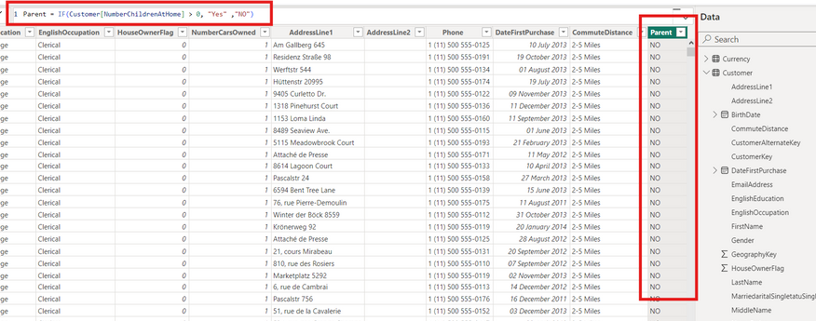


EXAMPLE: CALCULATED COLUMNS
In this case we’ve added a calculated column named Parent, which equals “Yes” if the [Total Children] field is greater than 0, and “No” otherwise
Check this
Example
Since calculated columns understand row context, a new value is calculated in each row based on the value in the
[Total Children] column
This is a valid use of calculated columns; it creates a new row “property” that we can use to filter or segment
any related data within the model

Slide 5
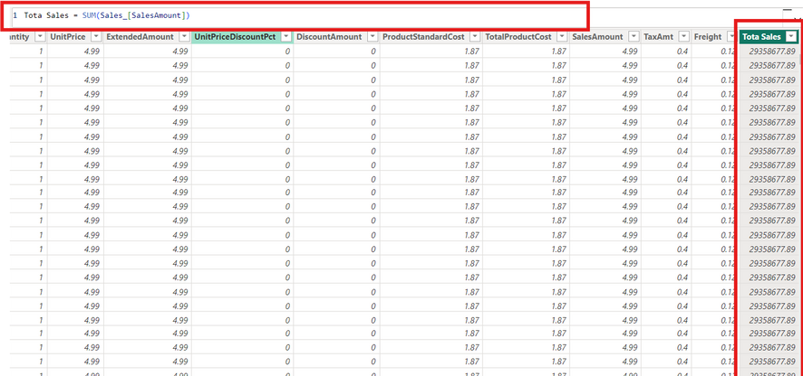


Here we’re using an aggregation function (SUM) to calculate a new column named TotalQuantity
not a valid use
Since this is an aggregation function, the same
returned in every row of the table
grand total is
This is not a valid use of calculated columns; these values are statically “stamped” onto the table and can’t be filtered, sliced, etc.

Slide 6

MEASURES
Measures are DAX formulas used to generate new calculated values
Have you got it?
Like calculated columns, measures reference entire tables or columns.
Unlike calculated columns, measures aren’t visible within tables; they can only be “seen” within a visualization like a chart or matrix (similar to a
calculated field in a PivotTable)
Measures evaluate based on filter context, which means they recalculate when the fields or filters around
them change
TIP:
Use measures to create numerical, calculated values that can be analyzed in the “values” field of a report visual

Slide 7


Thank you for joining me today to learn about Part -18 of Power BI!
Remember, Learning DAX is key to unlocking the full potential of Power BI for insightful reporting and visualization.
Stay tuned for more insights and tips on Power BI in our next Series.
Follow
Siddhika Shah

